Slide 1


Introduction to SON for Heterogeneous Networks
Self-Organizing Networks (SON) optimize the performance and efficiency of Heterogeneous Networks by intelligently managing the various devices and technologies within them. These networks enable seamless communication and connectivity, ensuring a futuristic and interconnected digital landscape.

Slide 2

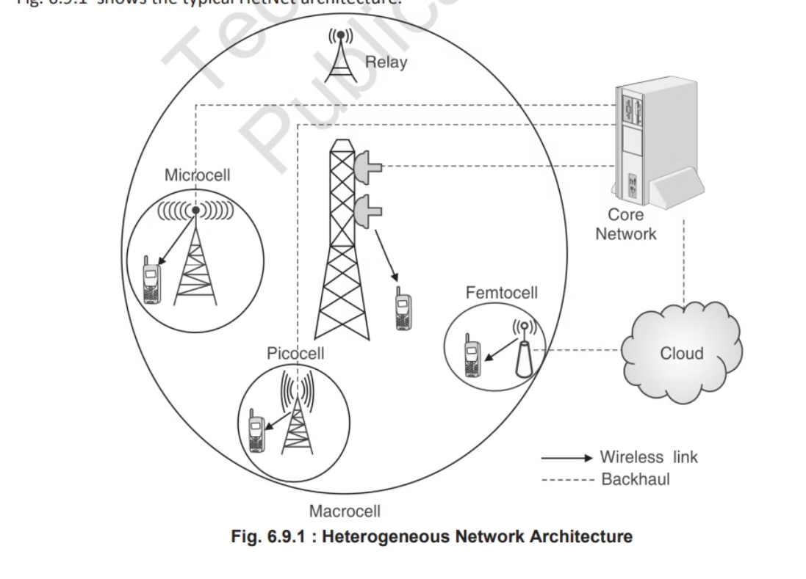
Architecture

Slide 3
SON Features for Heterogeneous Networks
Self-Configuration
Self-Optimization
Self-Healing
Auto-Detection of Network Elements
Interference Management
Load Balancing
Energy Efficiency
Spectral Efficiency
Quality of Service (QoS) Improvement

Slide 4



Case Studies of Successful SON Implementations
Telecommunications
Efficiency
Customer Satisfaction
Enhanced network coverage and performance.
Significant reduction in manual network management efforts.
Improved user experience and service quality.

Slide 5

Conclusion:
Self-Organizing Networks (SON) offer a smart solution for managing and optimizing heterogeneous networks
SON ensures better performance, improved coverage, and enhanced user experience. Overall, SON plays a crucial role in making complex networks more efficient, reliable, and user-friendly

